Slide 1


OMPUTEROME 2.0
USERS WORKSHOP
Faculty of Health and Medical Sciences,
University of Copenhagen, February, 2021

Slide 2
WELCOME TO THE C2 USERS WORKSHOP - ANDERS

Slide 3
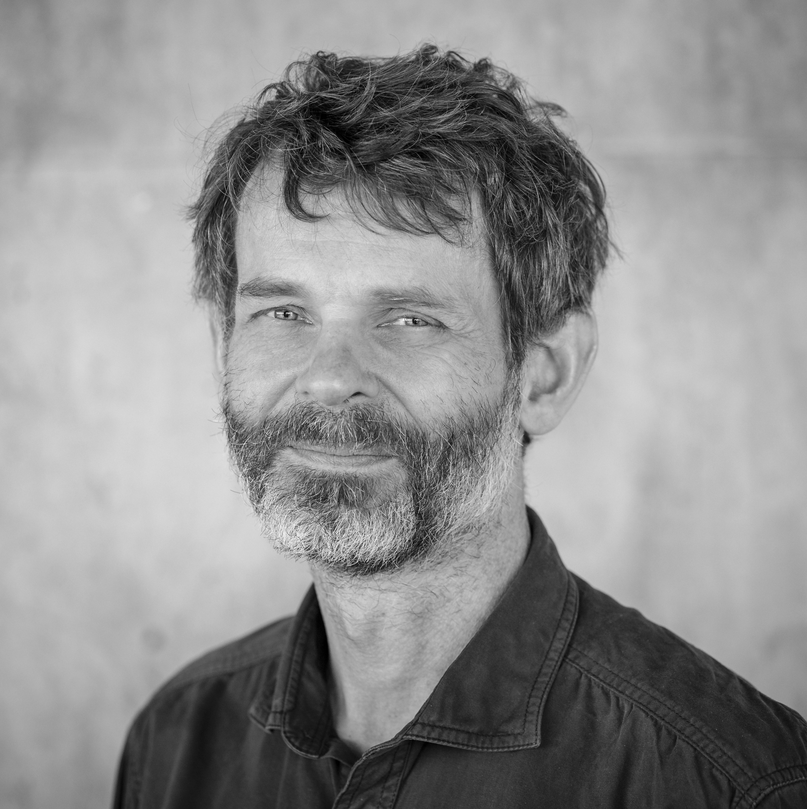
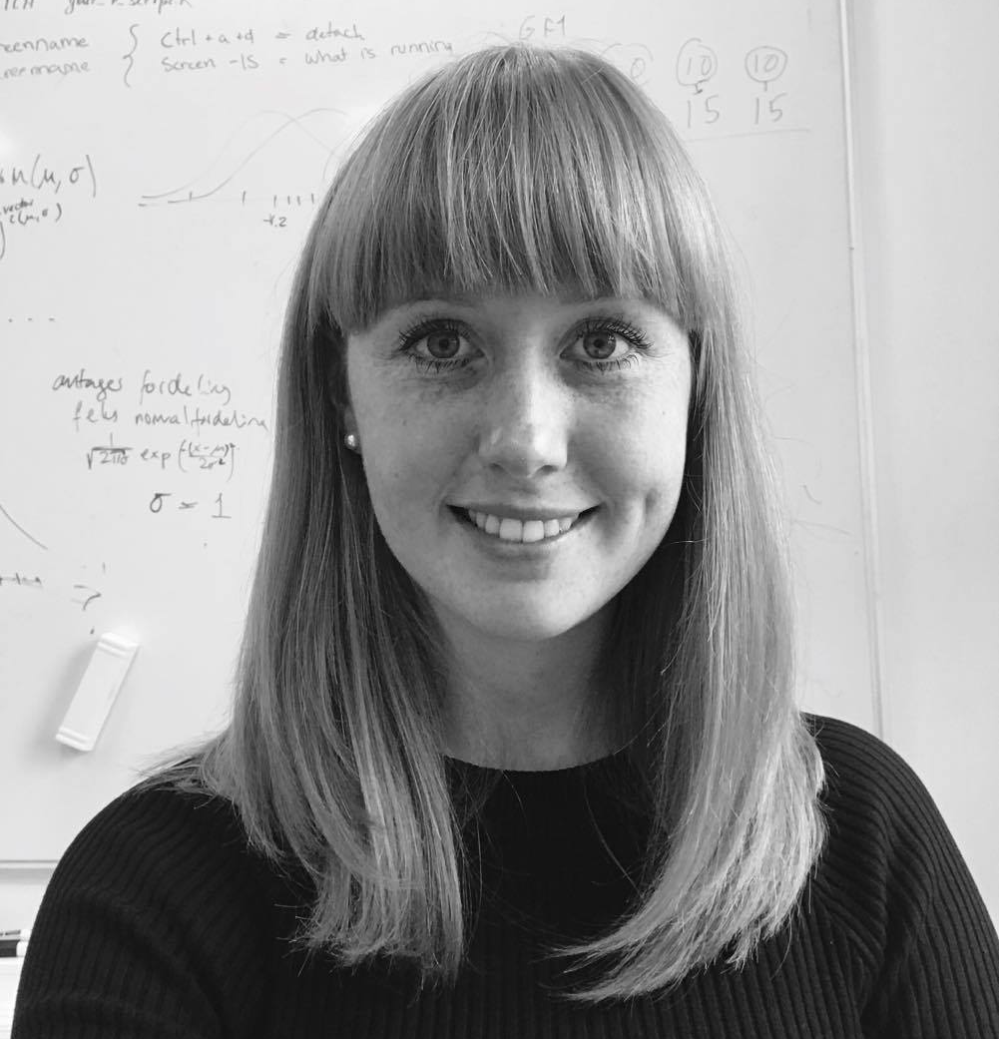
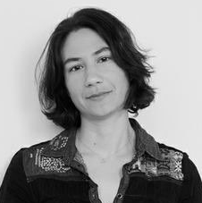

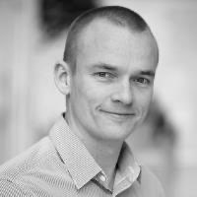
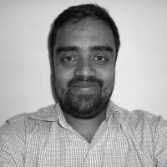
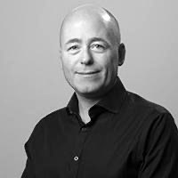
WHO ARE WE
CENTER FOR HEALTH DATA SCIENCE:
Anders Krogh, Professor, Head of Center
Thilde Terkelsen, Data Scientist
DANSTEM:
Magali Michaut, Research Consultant
ANDERS KROGH
THILDE TERKELSEN
MAGALI MICHAUT
GLOBE INSTITUTE:
Bent Petersen, Associate Professor
Shyam Gopalakrishnan, Associate Professor
KU IT:
Allan Have Sørensen, Head of Section
BENT PETERSEN
SHYAM GOPALAKRISHNAN
ALLAN HAVE

Slide 4
PART1
INTRODU TION

Slide 5
INTRODUCTION TO C2 - BENT

Slide 6
PART 2
THE BASI S

Slide 7
BEFORE LOG IN TO COMPUTEROME 2.0
GETTING STARTED:
https://www.computerome.dk/display/C2W/Getting+Started+-+new+users#GettingStarted-newusers-SSHlogintoComputerome2.0
ACCOUNT
ENTRUST APP
PUTTY OR MOBAXTERM
(WINDOWS ONLY)
THINLINK CLIENT
Request a Computerome 2.0 account (group) in KU-IT self-service. Standard or Sandbox.
Two-factor authentication. Install the Entrust app on your phone or alternatively use the SMS option.
Windows users should have an ssh client. MobaXterm users have to configure their ssh settings - see link.
IF you would like a virtual environment, install the ThinLink Client - make sure to keep it updated.

Slide 8
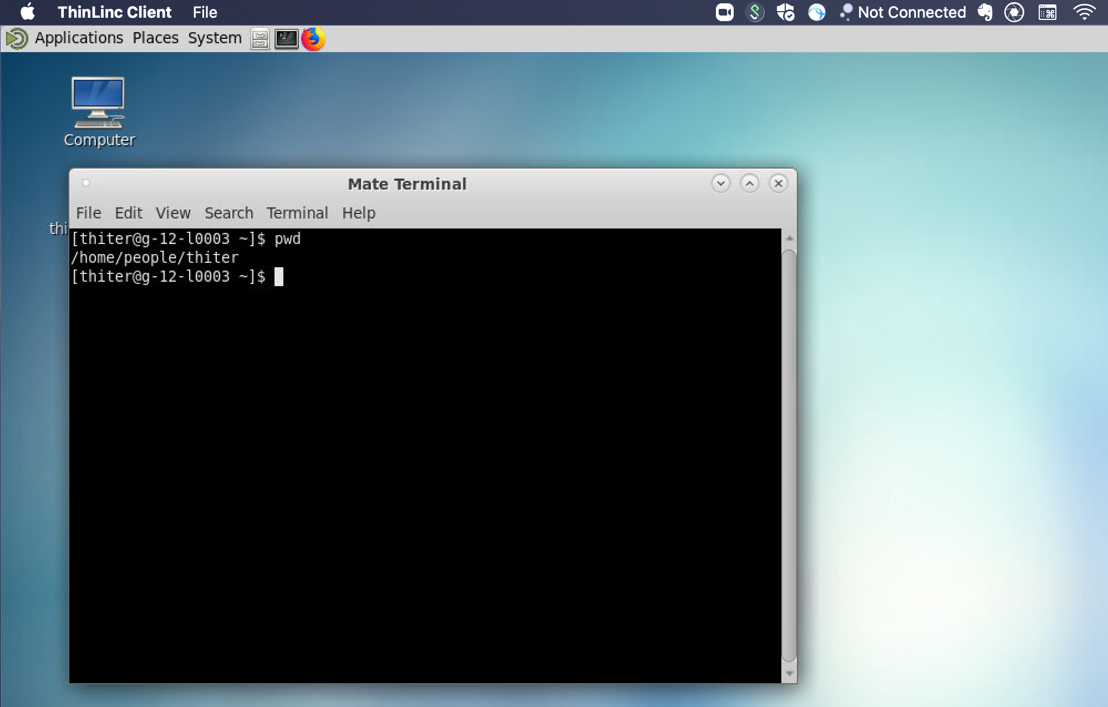
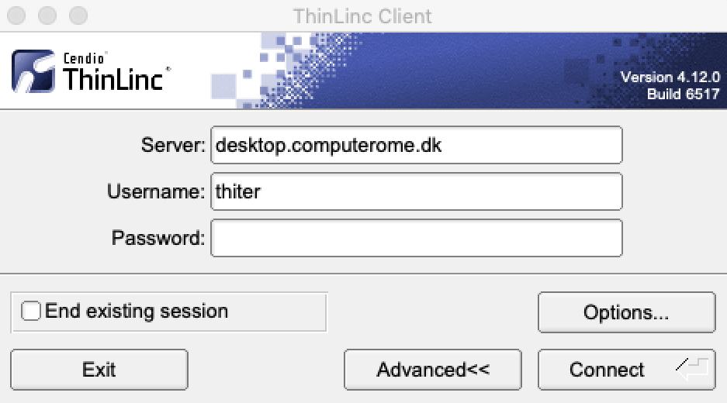
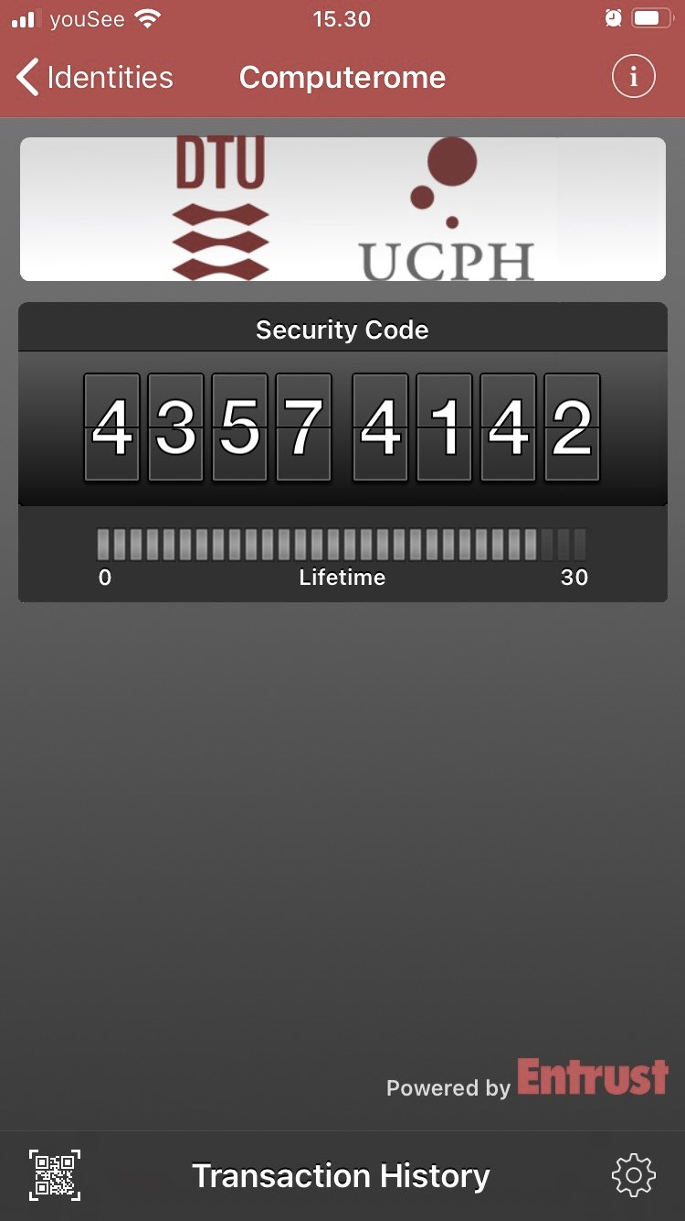
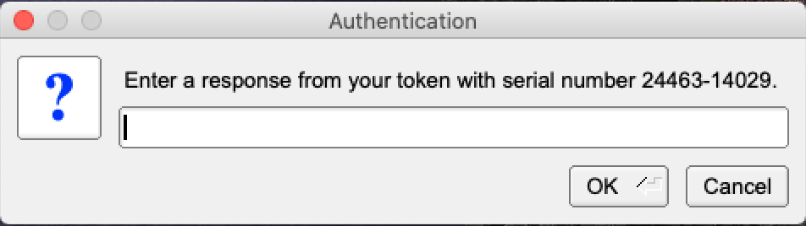
LOG IN TO COMPUTEROME 2.0 2.0
LOG IN WITH THINLINC
Download and install the ThinLinc Client
Open and enter your Username + Password
It make take a couple of minutes to connect
Enter the token from the Entrust App (or Confirm)
Open a terminal or click your way around
>
LOG IN WITH SSH
Open a terminal
ssh username@ssh.computerome.dk
Enter your password
Enter the token from the Entrust App (or Confirm)

Slide 9
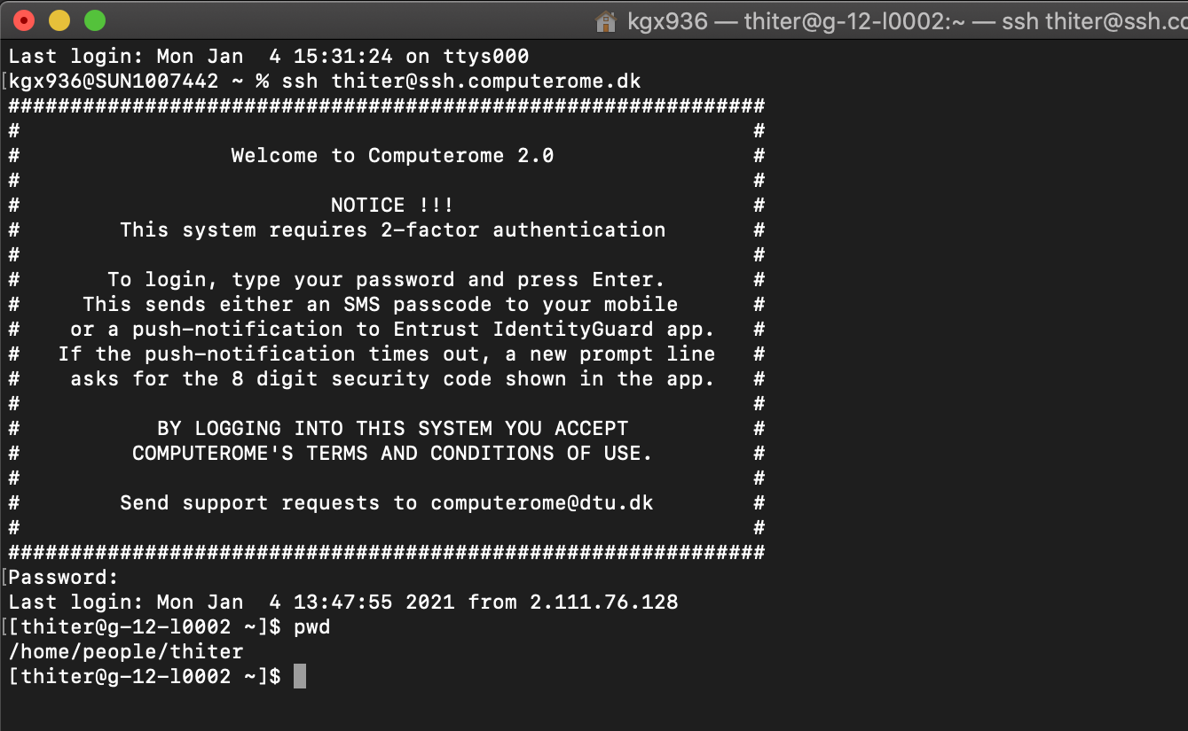
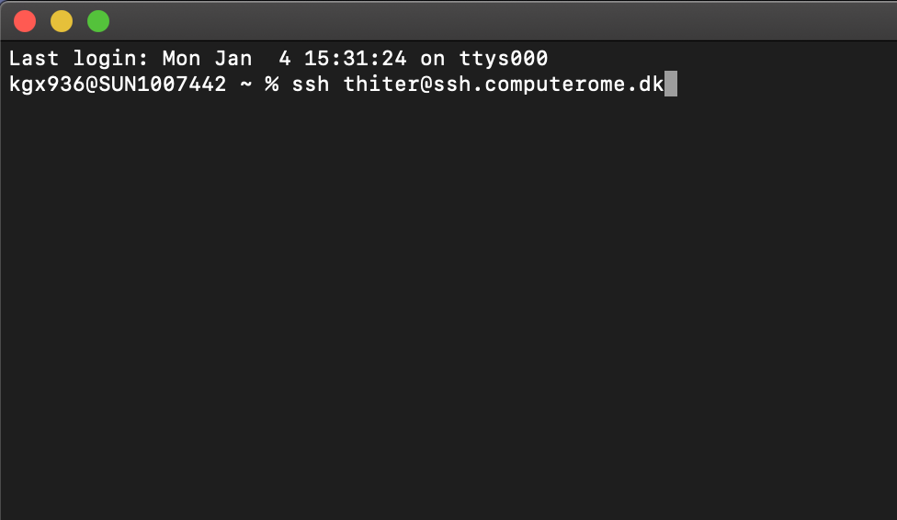
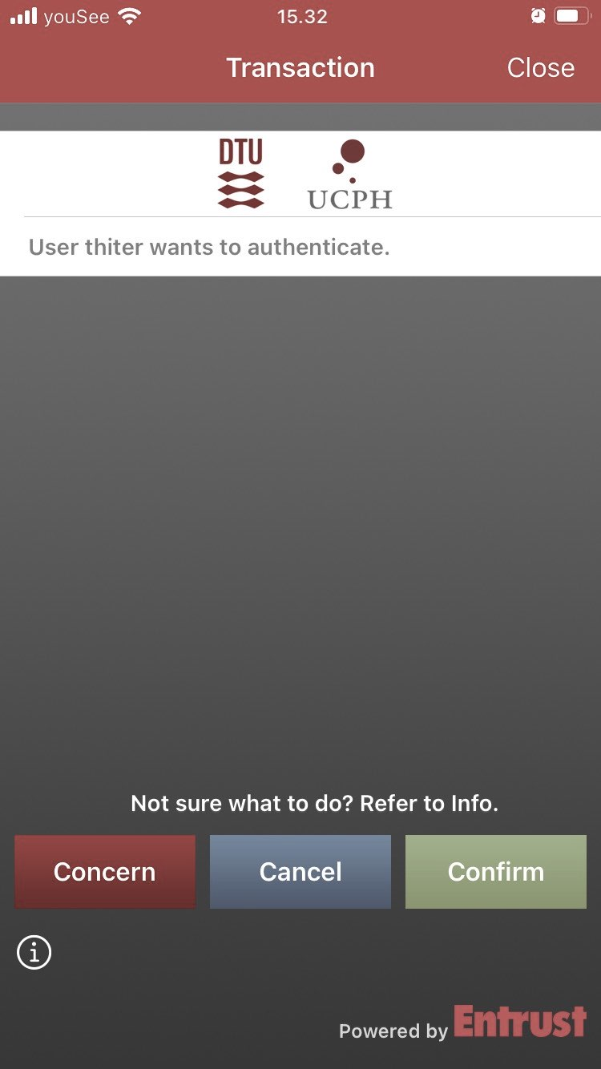
LOG IN TO COMPUTEROME 2.0 2.0
LOG IN WITH THINLINC
Download and install the ThinLinc Client
Open and enter your Username + Password
It make take a couple of minutes to connect
Enter the token from the Entrust App (or Confirm)
Open a terminal or click your way around
>
LOG IN WITH SSH
Open a terminal
ssh username@ssh.computerome.dk
Enter your password
Enter the token from the Entrust App (or Confirm)

Slide 10
C2 SANDBOX STRUCTURE
HOME
DATABASES
PEOPLE
PROJECTS
DB X
DB Y
DB Z
(…)
(…)
PRO 1
PRO 2
PRO 3
(…)
(…)
(…)
(…)
LOG IN
(…)
APPS
DATA
PEOPLE
WORK HERE

Slide 11
C2 SANDBOX STRUCTURE
1
/home/people/username
2
/home/databases
HOME
HOME
Your private directory.
This space is meant for configuration files.
Do NOT store data here (max 10G)
Do NOT run jobs from here.
Shared database resource
Databases include:
PEOPLE
DATABASES
Human genomes
Blast
TCGA / GTEx
dbSNP
ClinVar / COSMIC
…
DB X
DB Y
DB Z
(…)
(…)
(…)
LOG IN

Slide 12
C2 SANDBOX STRUCTURE
3
/home/projects/project
HOME
Your project directory.
./apps : project specific applications & modulefiles
./archive: dataproject specific data
./scratch: temporary & re-creatable data N.B will not be backed up!
./review used for peer-review.
PEOPLE
PRO NAME
YOUR PROJECT
APPS
ARCHIVE
DATA
PEOPLE
REVIEW
SCRATCH
APPS
RAW
GENERATED
WORK HERE
MODULEFILES

Slide 13
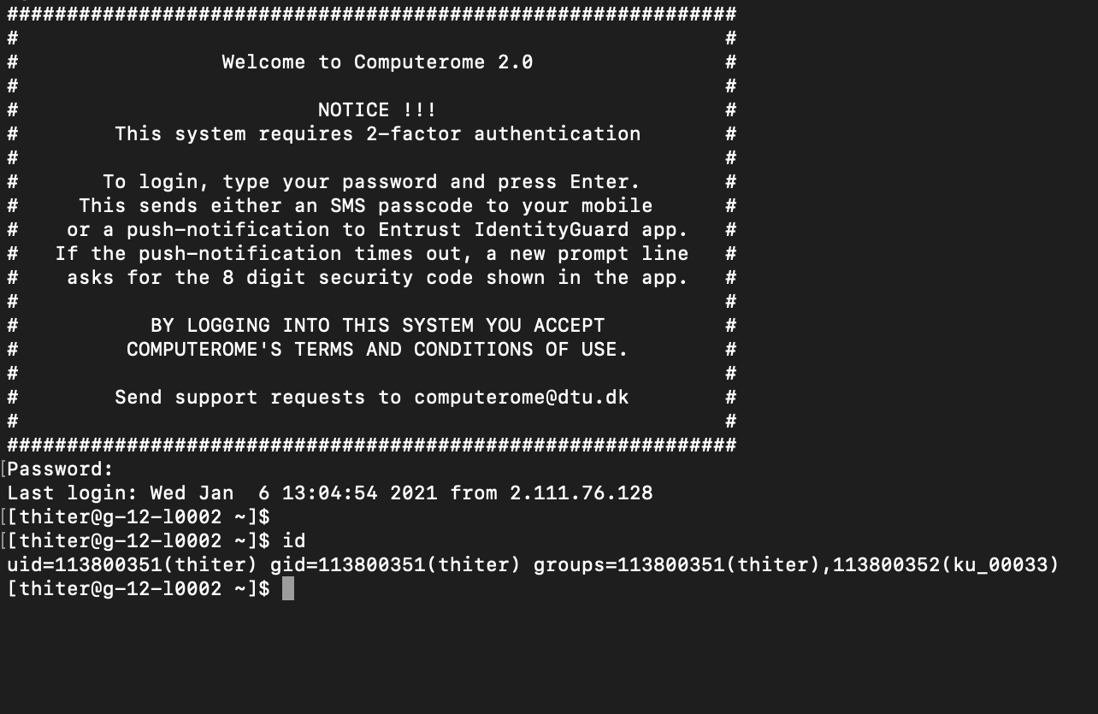
YOUR PROJECT AND GROUP
PROJECT
PROJECT NAME
Type in <id> to get this information
<project> usually refers to the projects funding.
<project_name> is the name given by the C2 team. Almost exclusively the same as <project>.
USERNAME
<username>
Your unique user ID. Can be connected to multiple projects and groups.
GROUP NAME
UNIX
<group_name>
ID assigned by DTU. Refers to the UNIX group, e.g. the projects/users access to resources.
Often the same as <project_name>.

Slide 14
GOOD TO KNOW
COMPUTEROME 2.0 WIKI - FIND EVERYTHING HERE
https://www.computerome.dk/
VIDEO TUTORIALS - HELPFUL TO WINDOWS USERS
https://www.computerome.dk/display/C2W/Video+Tutorials
BRUSH UP ON YOUR UNIX SKILLS
https://www.computerome.dk/display/C2W/Getting+Started+-+new+users?preview=/42205237/42205239/Hackinars_in_Computerome-wiki.pdf
CHECK YOUR USAGE ON C2
module load tools usage_script/2.0
usage -u username
CHECK YOUR USAGE ON C2
GETTING HELP
Write to computerome@dtu.dk
Subject description
System, e.g. Computerome main, sandbox, or <named> cloud system
Login issues, ThinLinc vs SSH login, username & error message(s)
Command line(s) used
Describe the problem including error messages

Slide 15
PART3
WORKING ON OMPUTEROME 2.0

Slide 16
WORKING ON COMPUTEROME 2.0 - MAGALI

Slide 17
REQUEST RESOURCES
>
DO NOT START ANY JOB ON THE LOGIN NODE
After you log-in, you can move around and have a look (e.g. cd, ls, cat….)
When you know what you want to do, you need to request the resources first
>
INTERACTIVE MODE WITH IQSUB
Just type iqsub in the command line
This will open a window for you to put the parameters for what you need
>
PLACE A SCRIPT IN THE QUEUE WITH QSUB
Specify the resources needed with PBS commands (e.g. in a PBS script)
Place the script in the queue with qsub
Explored in mode details this afternoon

Slide 18
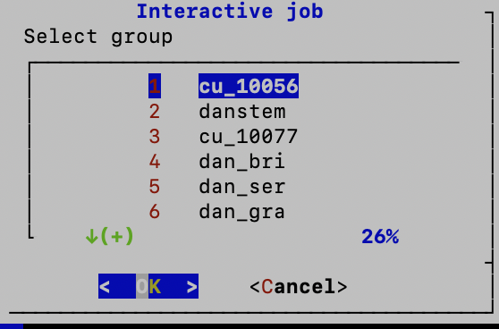
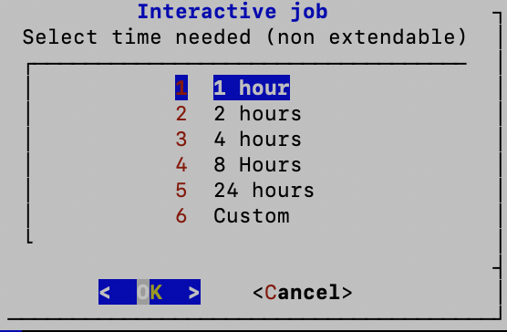
IQSUB PARAMETERS
>
PROJECT / GROUP
As part of which project / C2 group are you working
This affects who is paying
>
TIME NEEDED
This is the wall time. After this time, the resources are close.
Everything you are doing that is not saved is lost.
Better to put a bit longer than what you think you need (you can close before the end)
If you are done, you can exit with command exit ;-)

Slide 19
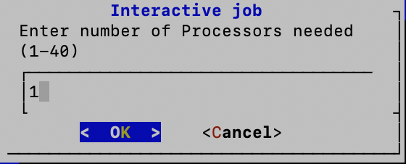
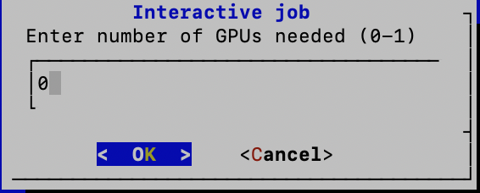
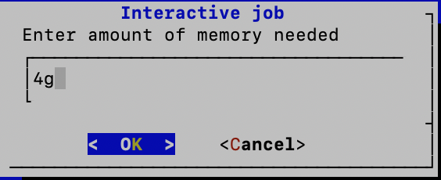
IQSUB PARAMTERS
>
NUMBER OF CPUs
Only useful for jobs that are parallelized and can benefit from several CPUs
If you don’t know, you can leave 1
>
NUMBER OF GPUs
Unless you know you need some GPU, leave it to 0
If you want to use GPU, you put 1
>
MEMORY NEEDED
Depends on the methods / software you use
E.g. mapping with STAR, you might want 80-120g

Slide 20
PART4
A BRIEF TECHIN AL INTERMEZZO

Slide 21
A BREIF TECHINCAL INTERMEZZO - ALLAN

Slide 22
PART5
2 MODULES & QUEING SYSTEM

Slide 23
MODULES, QUEING SYSTEM & SCRIPTS - SHYAM

Slide 24
PART6
OPTIMIZATION OF TIME & OST

Slide 25
OPTIMIZATION OF TIME AND COST ON C2 - SHYAM

